Slide 1
What We Do & Who We Serve
March 2026

Slide 2







About Families in Transition
We provide individuals and families in need:
  Hunger Relief
  Emergency Shelter
  Housing (Apartments)
  Supportive Services

Slide 3
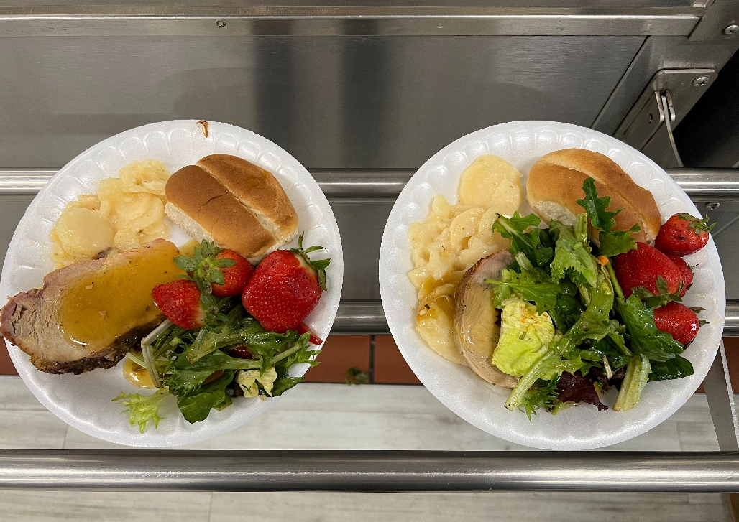
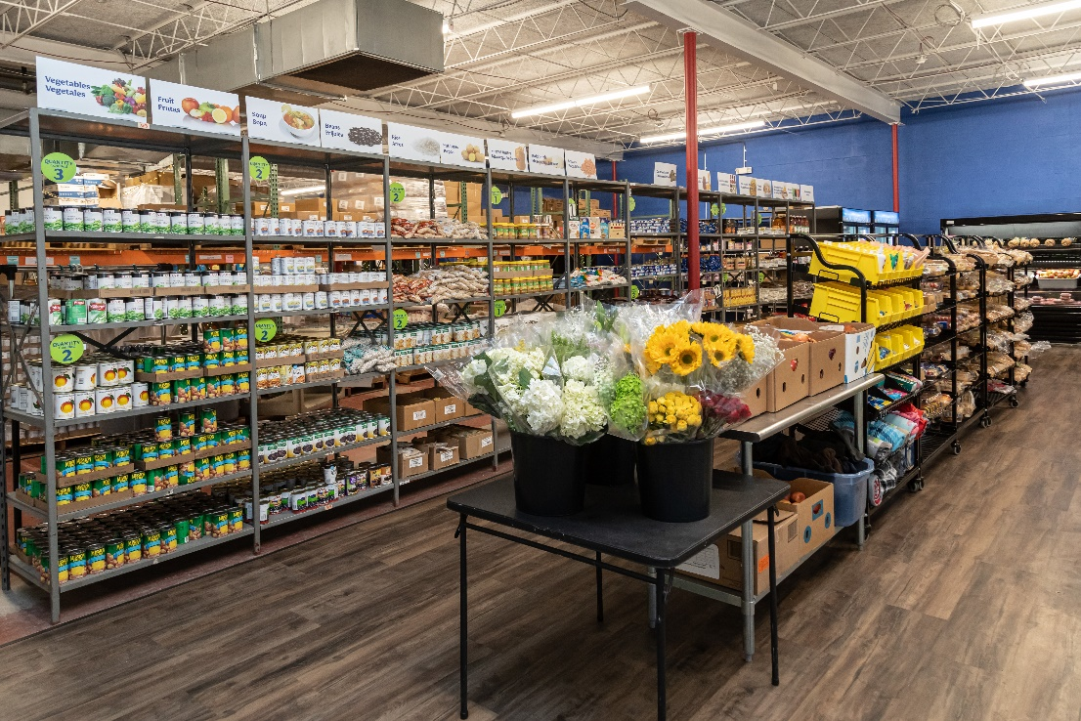
Hunger Relief 2025 Impact
Dining Services
Pantry
Served over 151,000 meals throughout the year to our program participants.
Served 14,929 individuals throughout the year via our food pantry services.

Slide 4
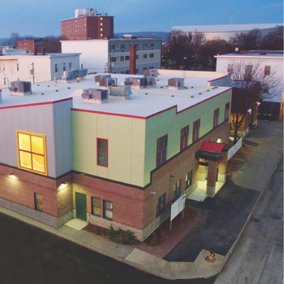
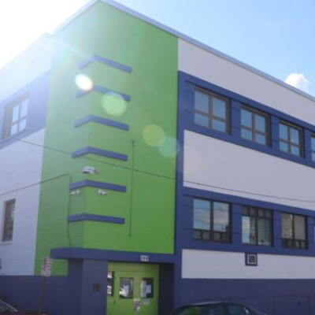
Shelter
2025 Impact
Family Emergency Shelter
  Serving families with children
  11 family units
  115 individuals served last year
Adult Emergency Shelter
  Serving men and women experiencing homelessness
  138 beds
  698 individuals served last year
Family Emergency Shelter
Adult Emergency Shelter

Slide 5
Housing 2025 Impact
236 affordable housing units (apartments) in Manchester
370 individuals were served through housing last year

Slide 6
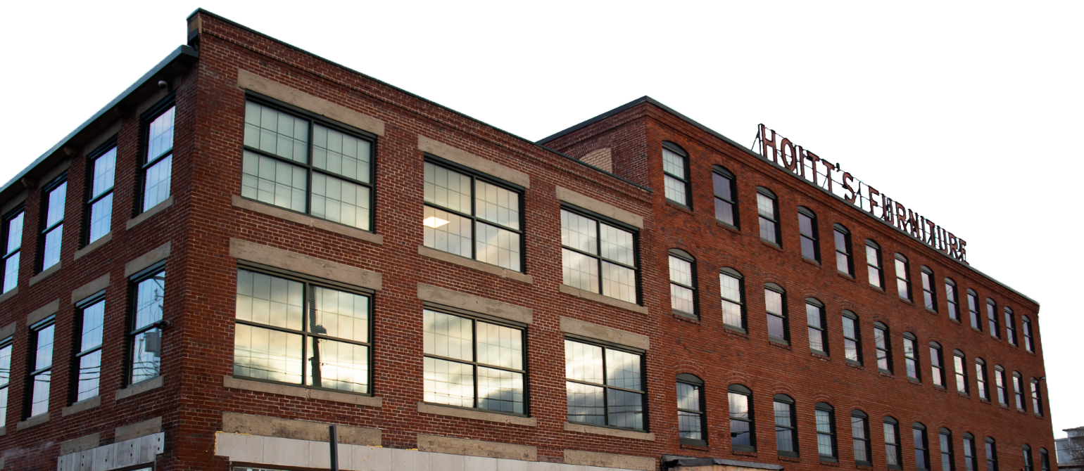

Supportive & Clinical Services
Case Management (Counselors)
Skill Building Workshops
Willows Substance Use Treatment and Recovery Housing
Social Events

Slide 7
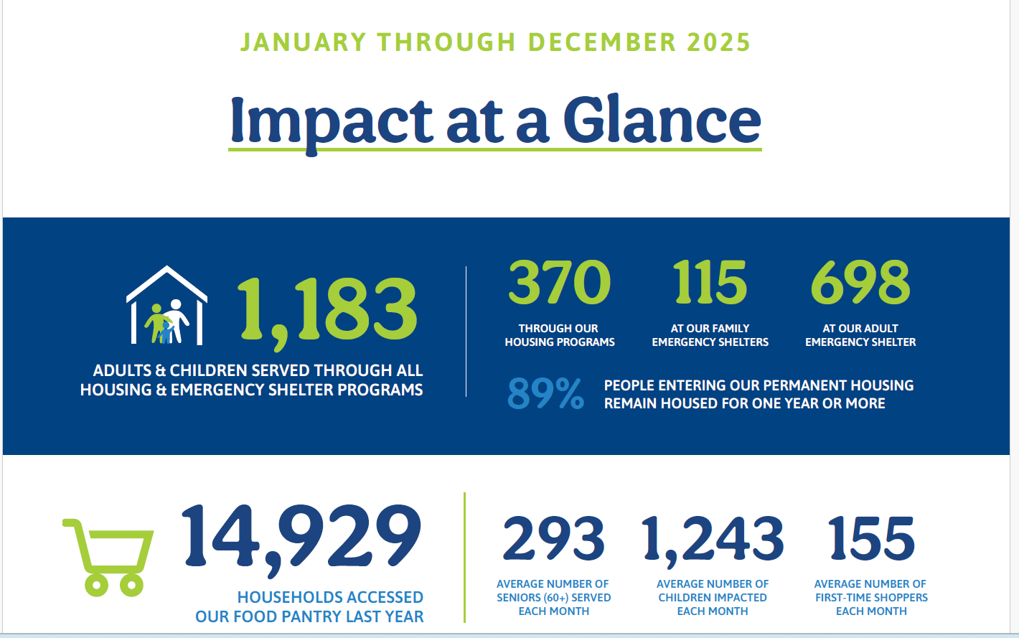
2025
Impact Statistics

Slide 8
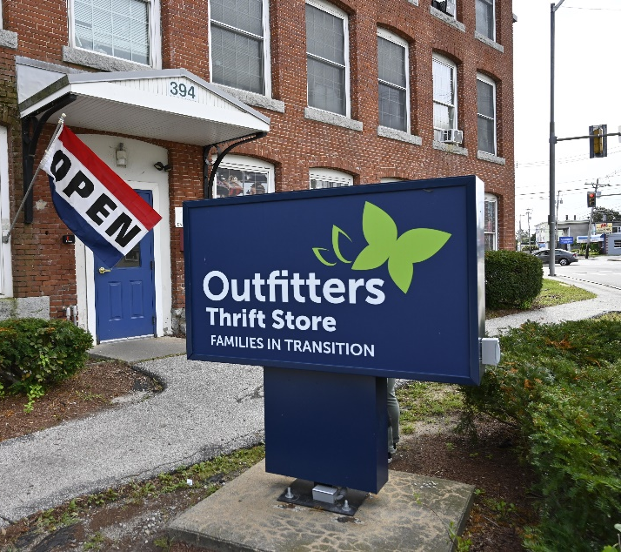
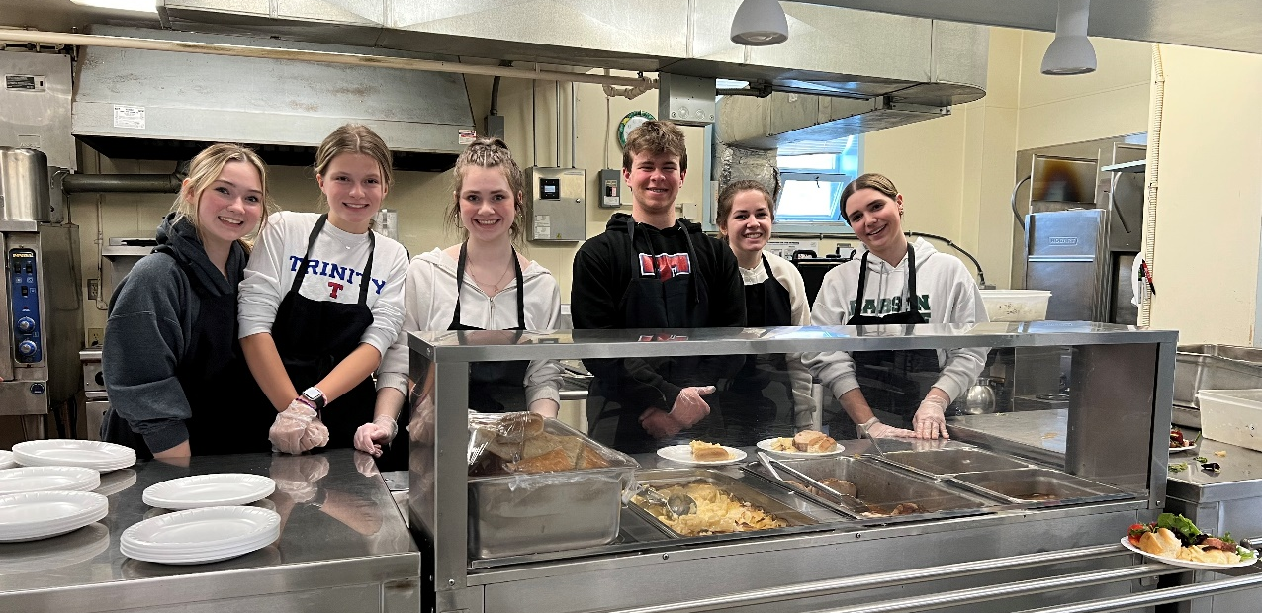
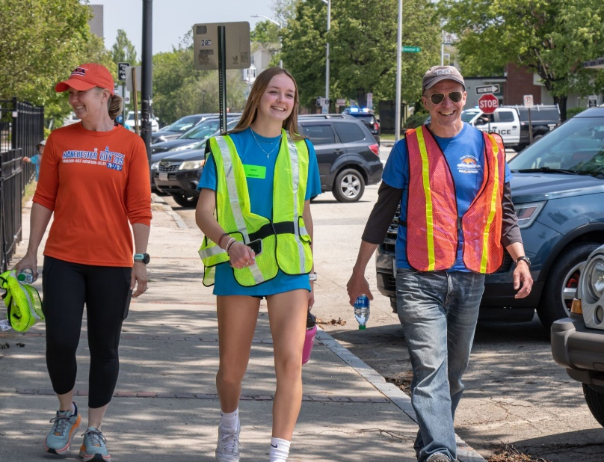
How You Can Help
Have friends and family sponsor your school Walk Against Hunger
Donate clothes, toys, and other gently used items
Volunteer at our events, food pantry, Outfitters Thrift Store, or shelters!

Slide 9



For more information
Contact Us
Families in Transition
122 Market Street
Manchester, NH 03101
P: 603.641.9441
E: info@fitnh.org
FITNH
@FITNH1
@FITNH1

